Slide 1
Module 3
MEMORY MANAGEMENT AND VIRTUAL MEMORY

Slide 2
Memory management
Memory is the important part of the computer that is used to store the data.
Its management is critical to the computer system because the amount of main memory available in a computer system is very limited.
At any time, many processes are competing for it. Moreover, to increase performance, several processes are executed simultaneously.
For this, we must keep several processes in the main memory, so it is even more important to manage them effectively.

Slide 3
Role of memory management
Memory manager is used to keep track of the status of memory locations, whether it is free or allocated. It addresses primary memory by providing abstractions so that software perceives a large memory is allocated to it.
Memory manager permits computers with a small amount of main memory to execute programs larger than the size or amount of available memory. It does this by moving information back and forth between primary memory and secondary memory by using the concept of swapping.
The memory manager is responsible for protecting the memory allocated to each process from being corrupted by another process. If this is not ensured, then the system may exhibit unpredictable behavior.
Memory managers should enable sharing of memory space between processes. Thus, two programs can reside at the same memory location although at different times.

Slide 4
Logical and physical address space
Logical Address
It is a virtual address generated by the CPU while a program is running.
It is referred to as a virtual address because it does not exist physically.
Using this address, the CPU access the actual address or physical address inside the memory, and data is fetched from there.
The hardware device called Memory Management Unit (MMU) is used for mapping this logical address to the physical address.
The set of all logical addresses generated by the CPU for a program is called the logical address space.
Logical address-Used in network layer-IP address-32 bit address e.g. IP address 190.10.134.76

Slide 5
Physical Address
Physical Address is the actual address of the data inside the memory.
The logical address is a virtual address and the program needs physical memory for its execution.
The user never deals with the Physical Address.
The user program generates the logical address and is mapped to the physical address by the Memory Management Unit(MMU).
The set of all physical addresses corresponding to the logical addresses in the logical address space is called the physical address space.
Datalink layer-to identify computer-mac address-05-0h-77-7i-88-9a-hexadecimal value-48 bit address

Slide 6
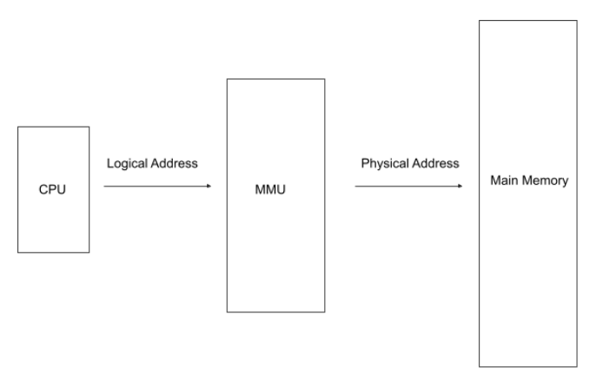

Slide 7
Comparison between Logical Address and Physical Address
Logical Address | Physical Address
It is a virtual address. | It is the actual location in the memory.
It is visible to the user. | It is not visible to the user.
It is generated by the CPU. | It is computed by the MMU.
It is used by the user to access the physical address inside the memory. | It is not accessible directly by the user.
The set of all logical addresses generated by the CPU is called the logical address space. | The set of all physical addresses corresponding to the logical addresses in the logical address space is called the physical address space.

Slide 8
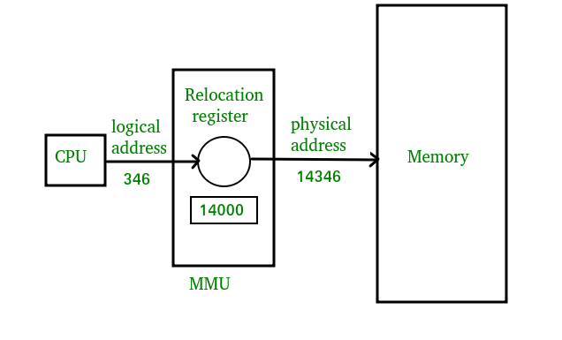
MMU Operation

Slide 9
Swapping
It is mechanism in which a process can be swapped temporarily out of main memory to secondary memory and secondary memory to main memory.
The exchange of two or more objects is referred to as swapping.
For example, programming can swap information between two variables or elements.
Swapping may particularly refer to a primitive method of memory management used in computer systems.
We swap processes from secondary memory to main memory or from main memory to secondary memory.
Swapping in the operating systems is a memory management technique in which we swap processes from secondary memory to main memory or from main memory to secondary memory.

Slide 10
The objective of swapping in the operating system is to increase the degree of multi-programming and to increase main memory utilization.
There are two steps in the process of Swapping in the operating system:
Swap In: Swap-in the process of bringing a process from secondary storage/hard-disc to main memory (RAM).
Swap Out: Swap-out takes the process out of the Main memory and puts it in the secondary storage.

Slide 11
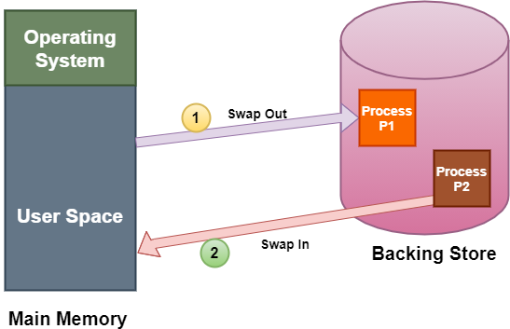
Fig.Swapping

Slide 12
Advantages of Swapping
Swapping processes improve the degree of multi-programming.
It provides advantages of Virtual Memory for the user.
Swapping reduces the average waiting time for the process because it allows multiple processes to execute simultaneously.
It helps in better memory management and efficient utilization of RAM.

Slide 13
Disadvantages of Swapping
The swapping algorithm must be perfect; otherwise, the number of Page Faults will increase, and performance will decrease.
Inefficiency will occur when there are common/shared resources between many processes.
The user will lose information if there is heavy swapping and the computer loses its power.

